Slide 1
Trip to Shegaon (Sant Nagari)

Slide 2
Introduction
Shegaon is the holy pilgrim place for devotees & visitors.
It is the Samadhi sthal of Sant Shri Gajanan Maharaj which built in 1910.
its largest trust temples in Vidarbh region in Maharashtra & known as “Pandharpur of vidarbh”.
The sansthan also famous for their management like pick & drop facility, parking, accommodation, mahaprasad, cleanliness & behavior of employee (sevadhari).
Apart from this temple sansthan has garden with lake which developed in
300 acre of area 5 km distanced from Temple sansthan.

Slide 3


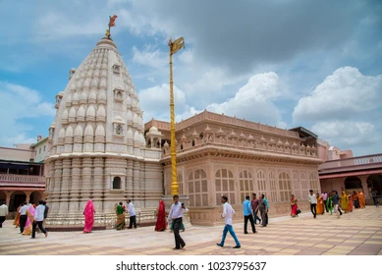
How to reach
BY Train
BY Road
Takes NH HWY 53
it takes 10-12 Hrs.
Take Nagpur train
Via BSL
Takes total 8-9 Hrs.

Slide 4

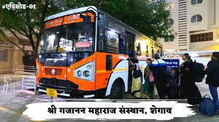
transportation

Slide 5
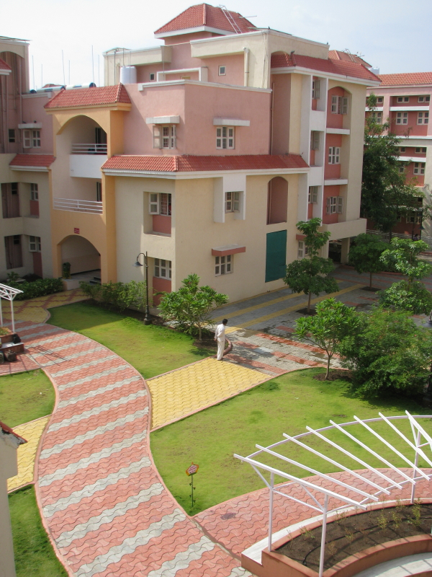
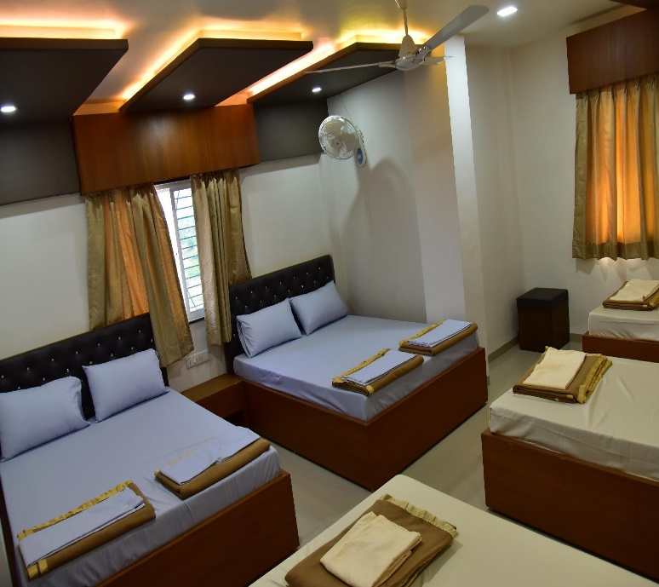
accommodation
BHAKTA NIWAS
5000 beds rooms available
All type of room available like simple, semi-luxury, luxury, duplex etc.
First comes first serve basis room provided

Slide 6
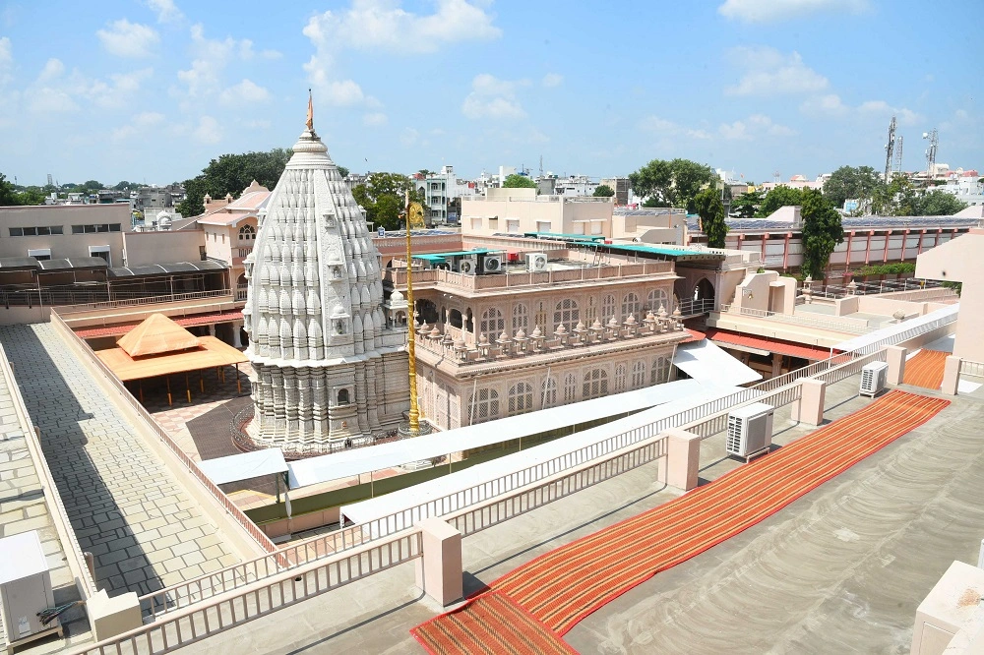
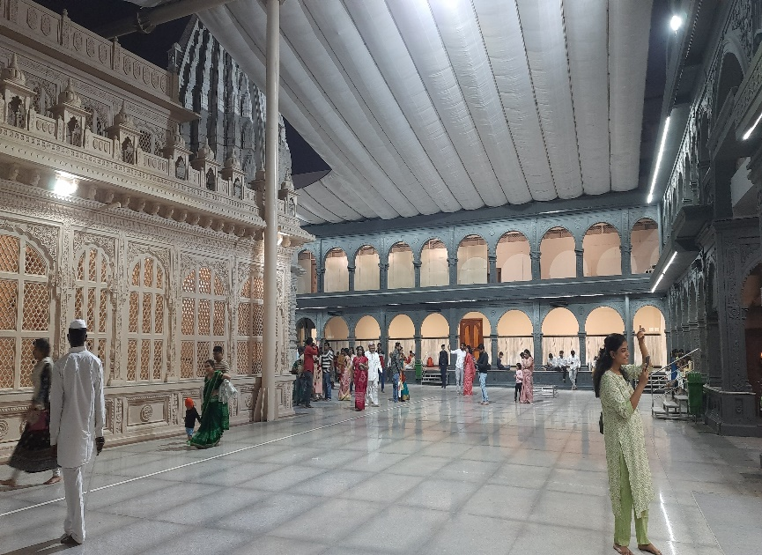
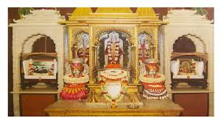
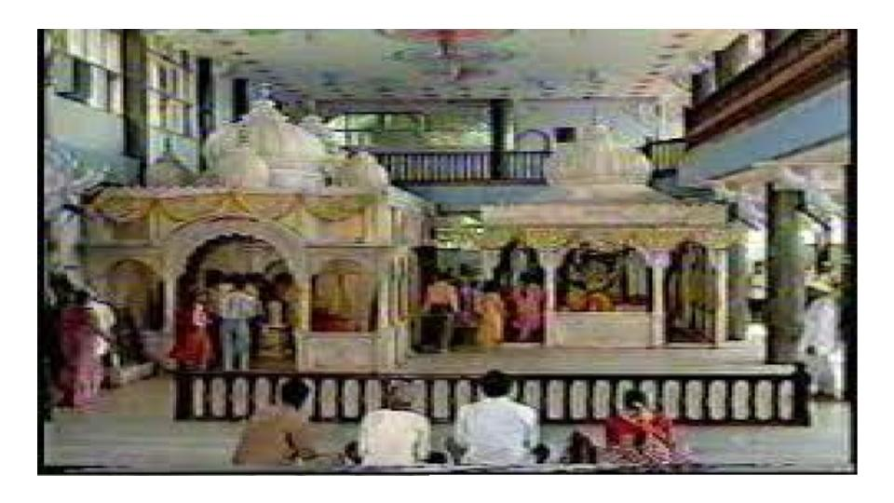
Temple darshan

Slide 7
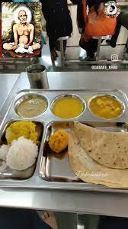
Maha prasad
Sansthan followed ideology that is “FOOD IS BRAHMA”
Sansthan offered Mahaprasad from 10 AM-9pm during this time on average 40000-45000 devotees takes advantages of this
On Peak day like Shri Pragat Din, Ram Navami this number reached 100000-150000 which is prepared by Sevadhari in limited periods
For Mahaprasad more than 42000 quintal wheat, sugar, rice & green vegetables are used in a year.
The Mahaprasad menu is simple Maharashrtian Thali like Dal Roti chapatti Rice khichadi & sweet

Slide 8
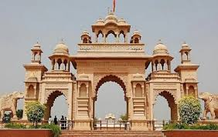
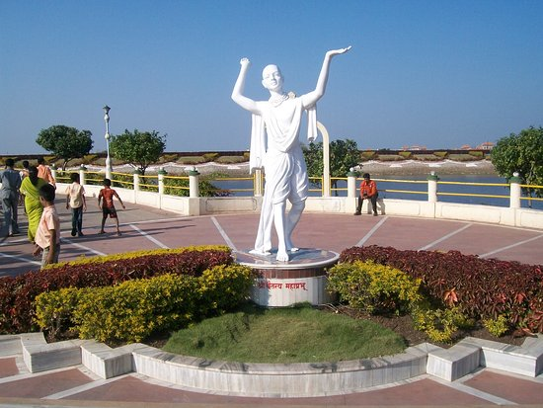
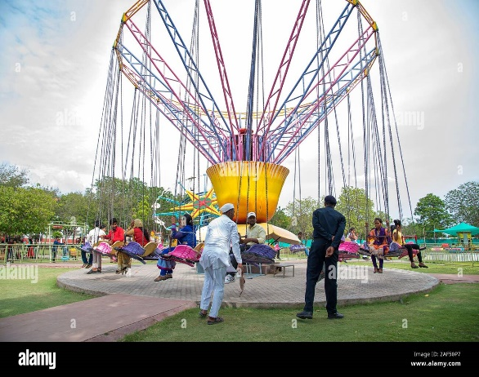
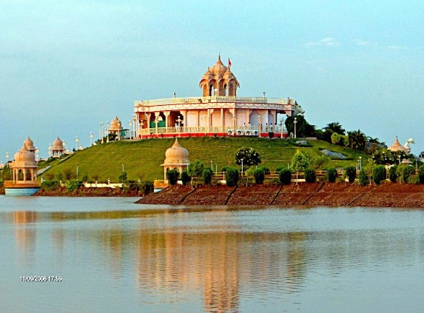
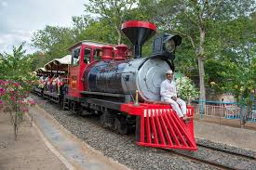
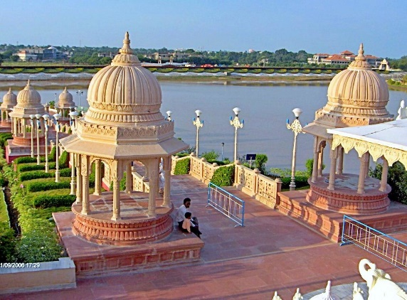
Place to visit
Anand sagar
INDIAN WELL-KNOWN SAINTS STATUS
GARDEN
CHILDREN PLAY AREA
TOY TRAIN
DHYAN KENDRA
HANGING BRIDGE
WATER PARK

Slide 9
thank YOU

